Slide 1
Leveraging Earth Observation Data for Informed Agricultural Decision-Making
By Team - Meteoric Minds

Slide 2
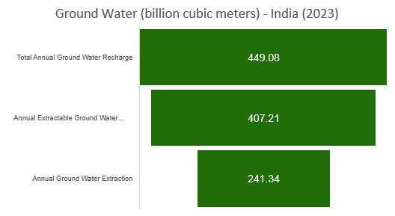
Groundwater in India
Groundwater (GW) is the water that seeps through rocks and soil and is stored below the ground. The rocks in which GW is stored are called aquifers.
The underground (hydrogeological) setting in India can be divided into -
Hard-rock aquifers of peninsular India: These represent around 65% of India’s overall aquifer surface area, mostly found in central peninsular India.
Alluvial aquifers of the Indo-Gangetic plains: Found in the Gangetic and Indus plains in Northern India, these have significant storage spaces.
70-80% of Indian farmers depend on Groundwater.
* Stage of Ground Water Extraction – 59.26%
Source: Ground Water Resource Assessment - 2023
* Stage of groundwater extraction is a measure of annual ground water extraction for all uses (irrigation, industrial and domestic uses) over annual extractable ground water resource

Slide 3
Steps
1
2
3
Objective
Data
Models
Understand the weekly trend of ground water in India and its states and forecast the ground water levels to take precautions on time.
NASA GRACE weekly data from 1st Jan 2023 to 27th May 2024. Features:
Ground water storage (gws_inst)
Root Zone Soil Moisture (rtzsm_inst)
Surface Soil Moisture (sfsm_inst)
Week Number
State (Added from external source)
LSTM
LightGBM
GRACE (Instruments) - Gravity Recovery And Climate Experiment: Since water has mass, changes in groundwater storage can be detected as changes in gravity. GRACE and GRACE-FO measurements help assess water storage changes in monthly, total surface, and groundwater depth.

Slide 4





Model Evaluation Metrics
Metric | Formula | Values
Mean Absolute Error (MAE)
Mean Squared Error (MSE)
Root Mean Squared Error (RMSE)
R-squared
Mean Absolute Percentage Error (MAPE)

Slide 5
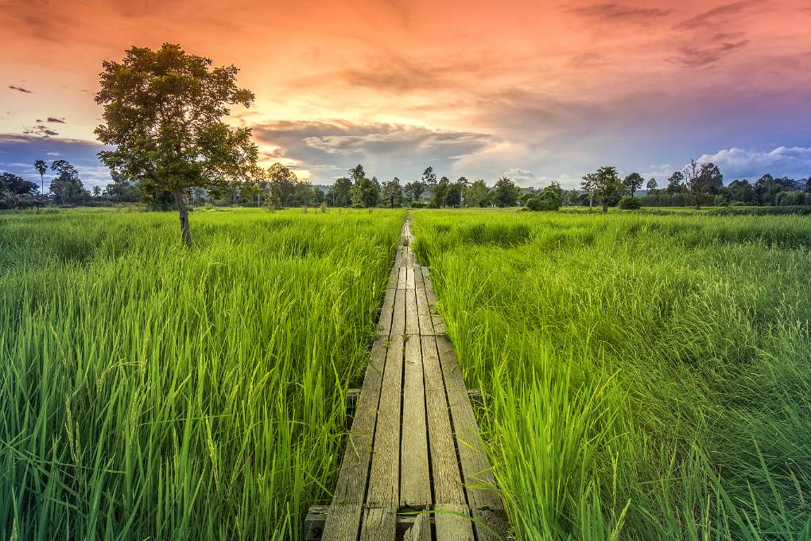
Actions
Warning System for farmers when Ground water has reached critical threshold.
Provisions for rainwater harvesting and water storage.
Develop Aquifer Management Plans to ensure the sustainability of groundwater resources in India

Slide 6
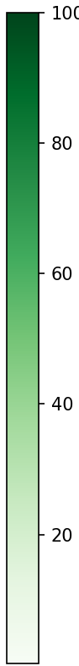
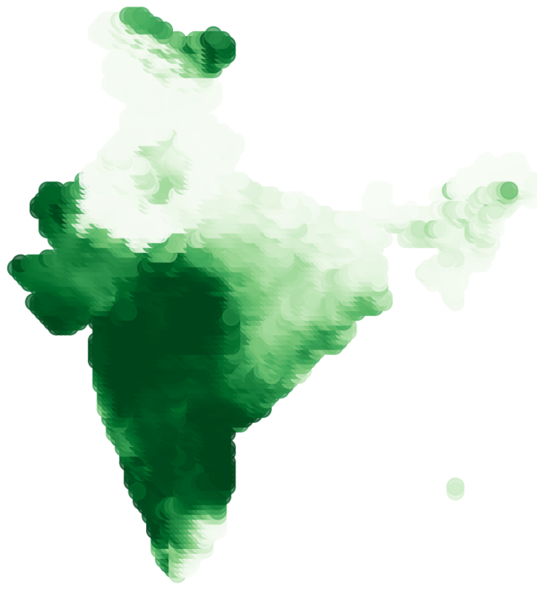
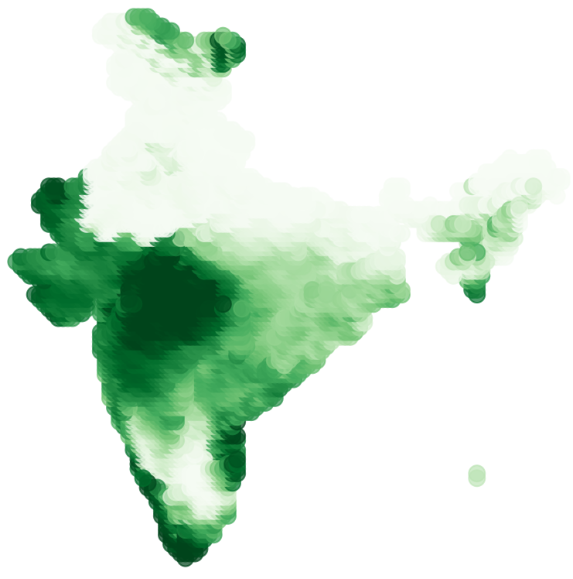
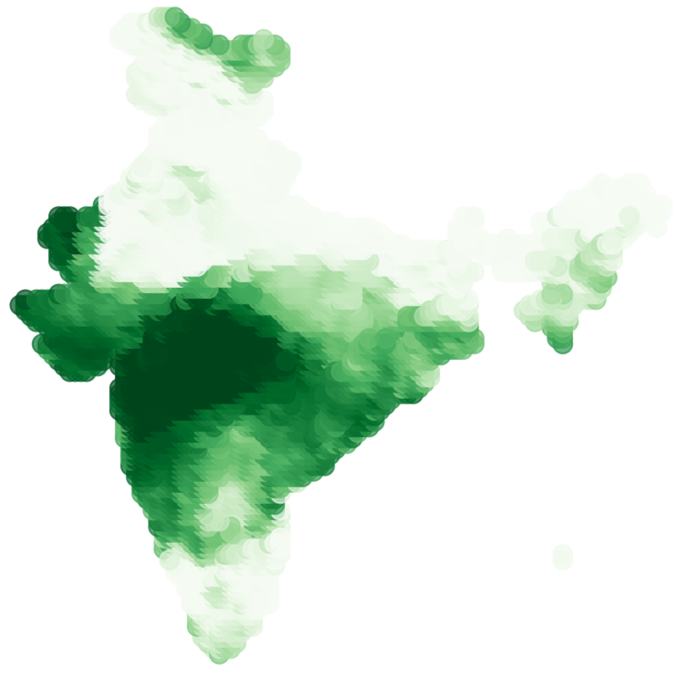
Ground Water Storage Variations across India
Ground Water Storage
Week 1 (2nd Jan 2023)
Week 53 (1st Jan 2024)
Week 71 (6th May 2024)
We can see significant falls in GWS across Southern part of India.

Slide 7
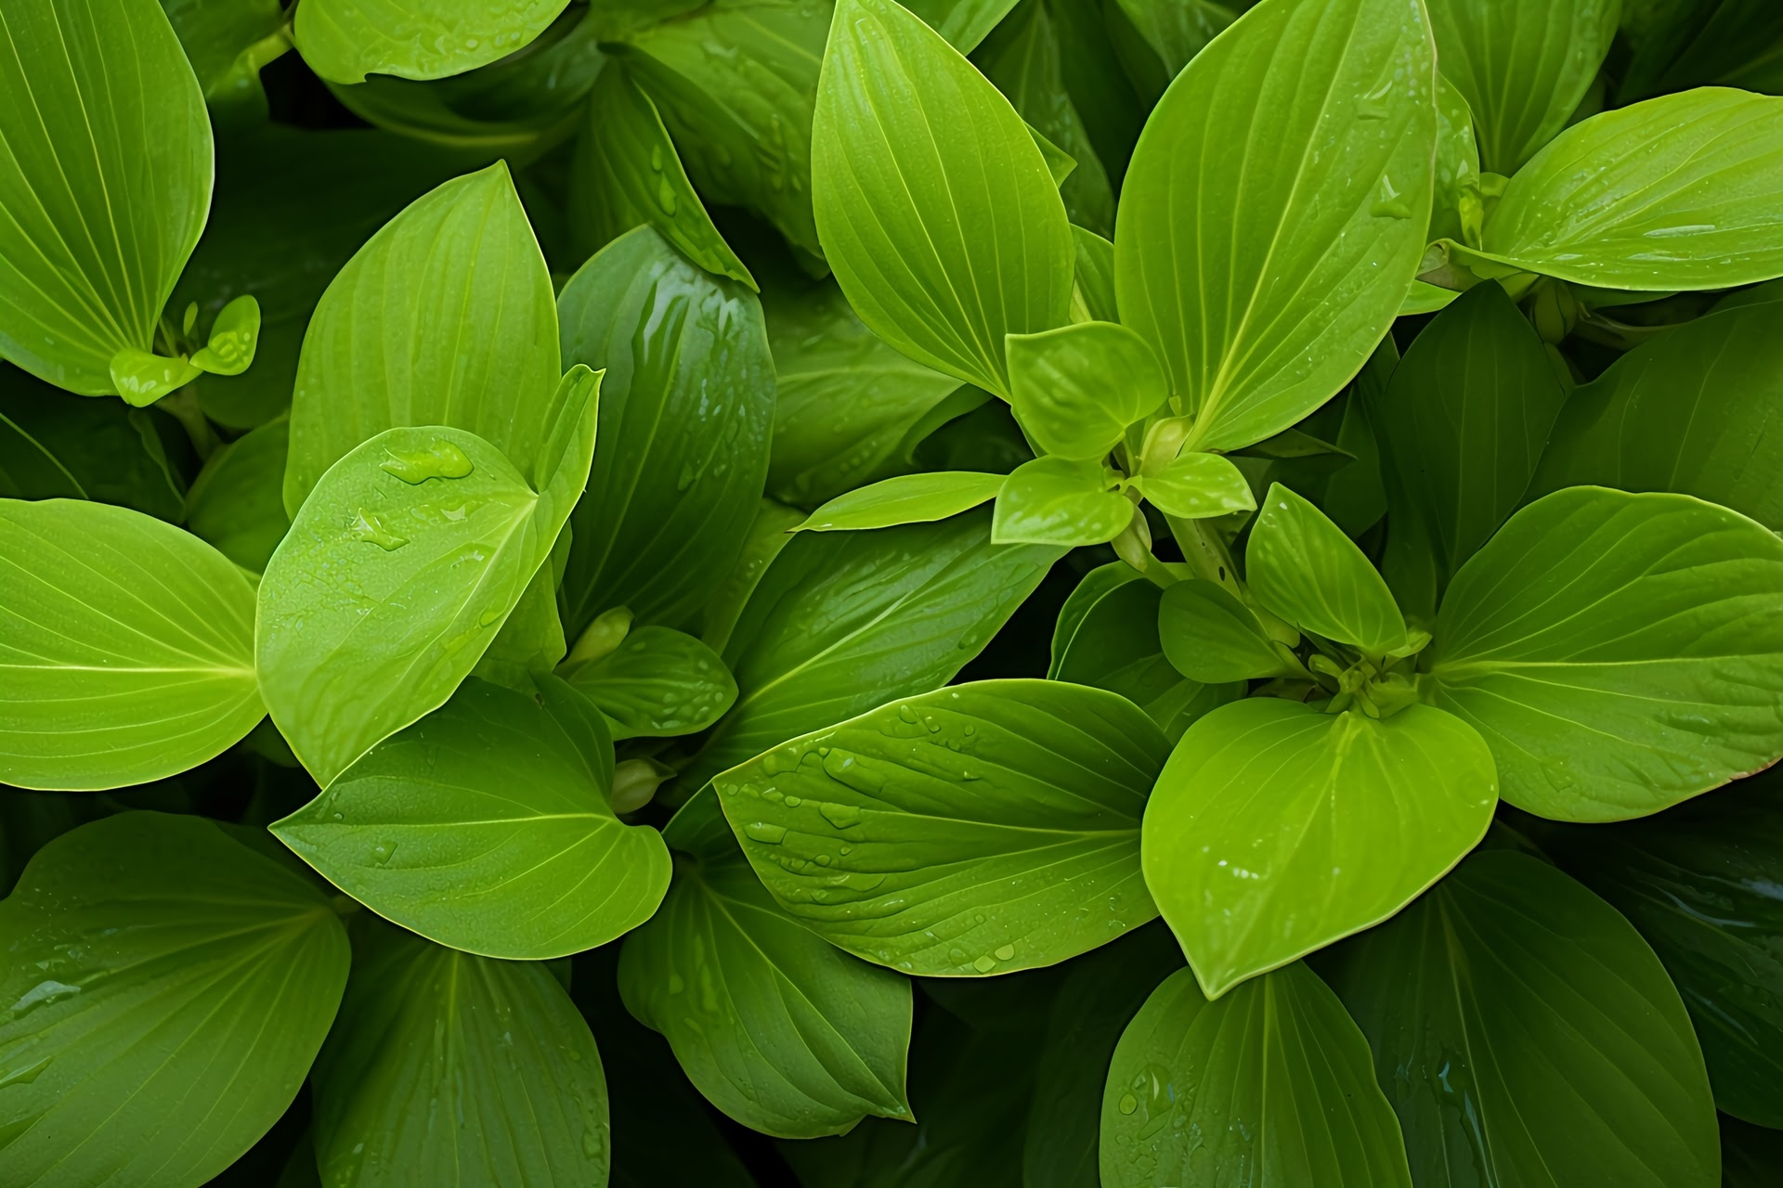
Future Prospects

Slide 8
Challenges Facing AI Implementation
High Initial Costs
01
Implementing AI solutions can be expensive, deterring smallholder farmers from adoption. Investment is often required in both technology and training.
02
Technical Skills Gap
The lack of technical skills among farmers can hinder the effective use of AI tools. Training and education are essential to bridge this gap and facilitate adoption.
Data Privacy Concerns
03
As data is collected, concerns arise regarding who owns this data and how it may be used. Farmers may hesitate to share sensitive information without clear data protection policies.

Slide 9
Thank you for watching!
Reporter

